Slide 1
Quality Circle Forum of India
presents
Problem Solving Techniques
- a simplified revised practical guide

Slide 2


Slide 3
    What is Control Chart?
    Control chart is a graphical device to aid in process control. It consists of a graph with a central line denoting the target value or standard and two limit lines on either side of the central line called ‘upper control limit’ and ‘lower control limit’. Quality measured periodically is plotted on the chart and status of control assessed.
UCL
CL
LCL

Slide 4

As said Control Chart
is a graphical device
to aid in process control

Slide 5
Central
Line
It consists of a graph with a central line denoting the target value or average quality value or mean value and

Slide 6
Upper
control
Limit
Central
Line
Lower
control
Limit
Two limit lines on either side of the central line called 'Upper Control Limit' and 'Lower Control Limit' generally indicated in dotted line.

Slide 7
Upper
control
Limit
Central
Line
Lower
control
Limit
Quality characteristics measured periodically is plotted on the chart and status of control assessed.

Slide 8

However well we may design a process or a system, we know that variation is always present due to inherent variations in the input for a given output
Upper
control
Limit
Central
Line
Lower
control
Limit

Slide 9
Such variations can be due to a variety of causes. They can be broadly classified into two categories viz.
CHANCE CAUSES
ASSIGNABLE CAUSES

Slide 10


You cannot do much. Certain variations are inevitable
Based on the requirement, conditions prevalent we accept certain variation as inevitable.

Slide 11

CURSE THE ELECTRICITY BOARD !!!
@#$* voltage fluctuation has affected my computer!!!
Sometimes such variations may not be desired.

Slide 12

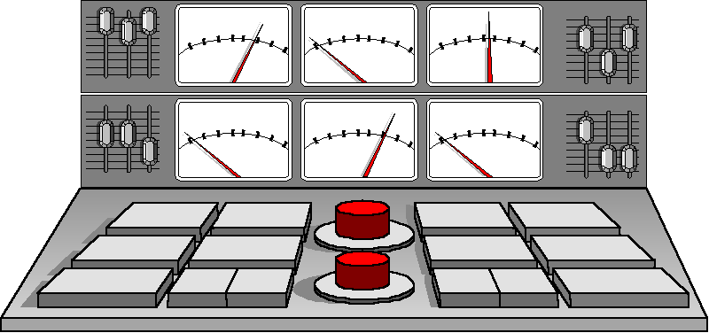
John, Load shedding is now inevitable. Demand exceeds supply by 30%
But the given conditions like demand out stripping the supply,

Slide 13

Gentlemen, if things continue to stay as they are we are definitely doomed. What is required is massive changes in infrastructure
Lack of basic infra structure needed etc. variations do occur.

Slide 14

Certain variations are accepted as inevitable. Depending upon the working condition such inherent variations are also accepted as due to "Chance Causes”.

Slide 15

CHANCE CAUSES
Sir, I noticed Small variations in the output. The variations are very minor and is within specification limits.
Some amount of variations are bound to be there..
However sophisticated the systems, production condition etc., Chance Causes are bound to be there

Slide 16

ASSIGNABLE CAUSES
My GOD how did this happen? What do I say to the BOSS !!!
They are not present under normal working condition. They suddenly creep in due to various reasons causing changes in the control parameters.

Slide 17

They can be due to setting changes in a machine.

Slide 18

Changes in operations/processes

Slide 19
Changes in raw material batches

Slide 20

Operator error etc. They are all called assignable causes.

Slide 21

The process seems to to be in a state of Statistical Control.
When no assignable causes of variation are present in a process and it operates only under a constant system of chance cause, the process is said to be in a state of statistical control.

Slide 22

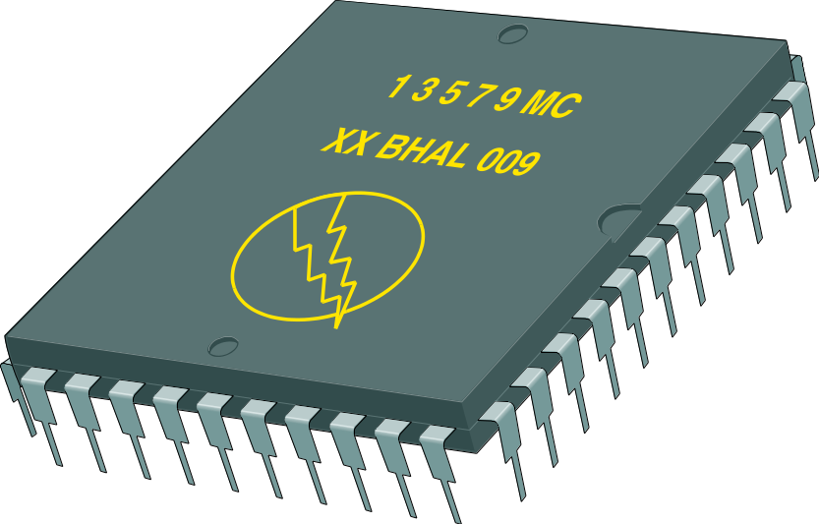
In that state, the process produces consistent quality.

Slide 23

My GOD !! How did this happen.
Occasionally, assignable causes may enter the process resulting in a change to out-of control state when process output shows large variation and hence fails to meet requirements.

Slide 24

A major objective of Statistical Quality Control is to quickly detect process shifts due to assignable causes, so that corrective action can be taken to prevent nonconforming products being turned out.
Sir, if you notice there is a definite process shift here.

Slide 25
Control Chart
Upper
control
Limit
Central
Line
Lower
control
Limit
This is facilitated by a Control Chart

Slide 26

Upper
control
Limit
Central
Line
Lower
control
Limit
Thus a Control Chart is an on-line process control technique widely used for process control.

Slide 27
Central
Line
As stated earlier it consist of a graph with a central line denoting the target value

Slide 28
Upper
control
Limit
Central
Line
Lower
control
Limit
and two limit lines on either side of the central line called upper and lower control limits.

Slide 29
Upper
control
Limit
Central
Line
Lower
control
Limit
Quality characteristics measured periodically is plotted on the chart and status of control assessed.

Slide 30
The process seems to be within control. I do not think we need to make any adjustment.
Upper
control
Limit
Central
Line
Lower
control
Limit
As long as the plotted point is within the control limits, the process is left alone.

Slide 31
Upper
control
Limit
Central
Line
Lower
control
Limit
However, a point may fall on or below the lower control limit,

Slide 32
Upper
control
Limit
Central
Line
Lower
control
Limit
on or above the upper control limit. It is an indication of the presence of assignable causes which needs to be eliminated by suitable corrective action.

Slide 33
RUN
TREND
Sometimes even points within the control limit can be attributed to assignable cause.
We will see them later on.

Slide 34
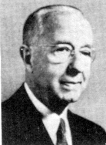
The control chart was first proposed in 1924 by Dr. Walter A. Shewhart an engineer in the Bell Telephone Laboratories USA with a view to eliminate abnormal variation in process output by distinguishing variation due to assignable causes from those due to chance causes.

Slide 35
How to set control limits?

Slide 36
Control limits are the permissible limits under chance cause variation or under state of statistical control. For a measurable quality characteristic, chance cause variation will result in a pattern of variation called Normal Distribution which is a Symmetrical Frequency Distribution. This distribution is described completely by the mean and standard deviation.

Slide 37
One feature of this distribution is that with a span of ± 3 standard deviation (± 3 σ) from the mean, 99.73% of observations lie. Thus ± 3 standard deviation limits from the mean form the limits for variation due to chance cause. Hence, on the control chart, control limits are set at ± 3 standard deviation (±3 σ) from the mean.

Slide 38
TYPES OF CONTROL CHARTS
They are classified into two categories viz.
Variables Control Charts
and
Attributes Control Charts

Slide 39
VARIABLE
CONTOL
CHARTS

Slide 40
Variable Control Charts
If the quality characteristic can be measured with the help of an instrument, equipment or measuring process, it is called a measurable characteristic.

Slide 41
Variable Control Charts
For example, diameter

Slide 42
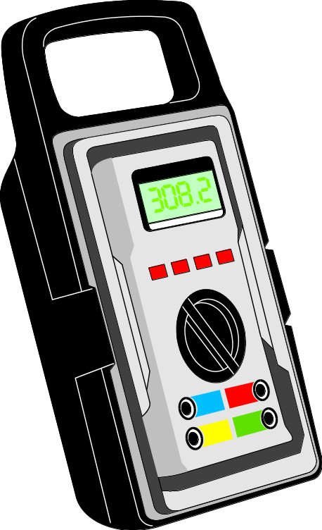
Variable Control Charts
Electrical Resistance,

Slide 43

Variable Control Charts
Yield

Slide 44
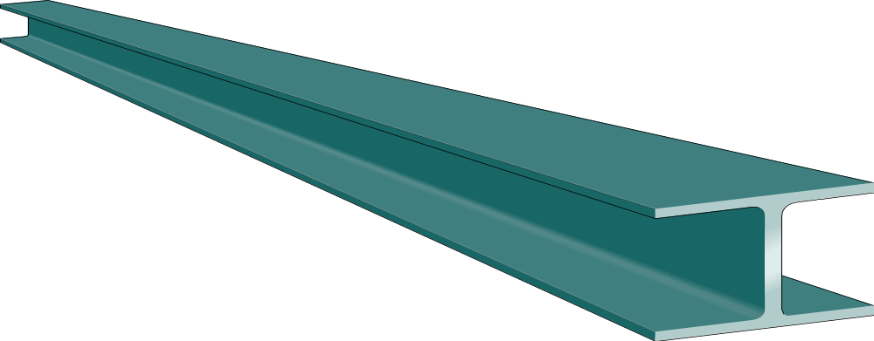
Variable Control Charts
Carbon content

Slide 45

Variable Control Charts
Life of a bulb etc

Slide 46

In such cases, it is convenient to describe the quality characteristic by average and measure of variability by range or standard deviation.

Slide 47
Control charts used for such variables are called Variable Control Charts

Slide 48
ATTRIBUTES
CONTROL
CHARTS

Slide 49

ATTRIBUTES CONTROL CHARTS
Many quality characteristics are not measured on a quantitative scale.

Slide 50
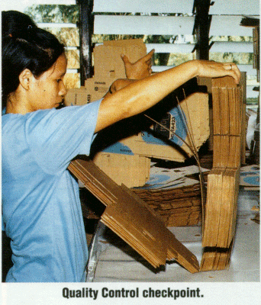
ATTRIBUTES CONTROL CHARTS
In such cases, we classify the product as good or bad, acceptable or non acceptable,

Slide 51
ATTRIBUTES CONTROL CHARTS
RAW
Material
RAW
Material
RAW
Material
RAW
Material
RAW
Material
PASS
REJECT

Slide 52
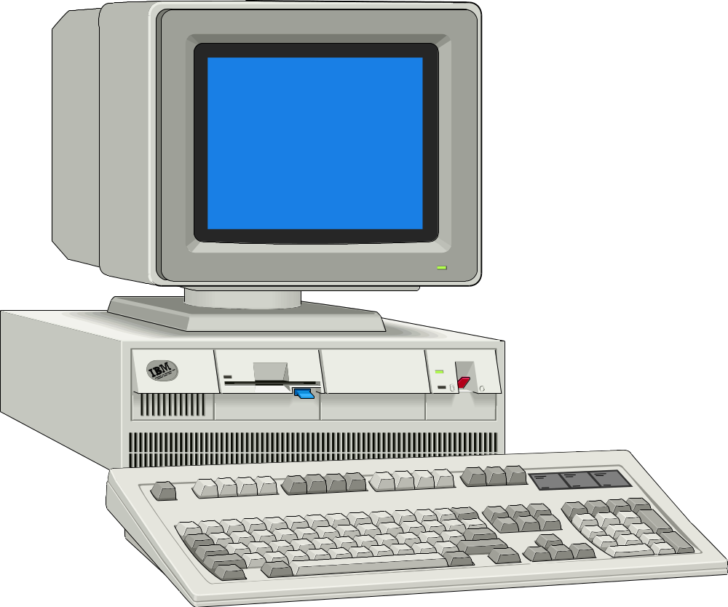
ATTRIBUTES CONTROL CHARTS
1) Flickering Screen
2) Drive not working
3) Bad sectors
in HDD
Or we may count defects in a product

Slide 53

Data obtained in this case are called Attributes. Control charts for attributes are called Attribute Control Charts

Slide 54

PRELIMINARIES
TO THE SETTING UP
OF A
CONTROL CHART

Slide 55

That resin quality parameter is on the borderline. check up for the blister problem.
Choice of Quality Characteristic: anything affecting the performance of the product should naturally be the priority.

Slide 56
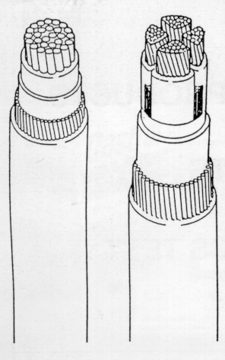

These may be features of materials used or components or parts of product.For example, tensile strength of core wire of cables, thickness of insulation, life of incandescent lamps etc.

Slide 57

Choice of Place for Control
The place of control is a strategic point.

Slide 58

Considerations of place of control are:
reduction in scrap,
increase in productivity,
no occurrence of deviations.

Slide 59

Choice of Rational Subgroups

Slide 60
Assignable cause
Upper
control
Limit
Central
Line
Lower
control
Limit
Basic aim of control chart is to separate the variation due to assignable

Slide 61
Chance cause
Upper
control
Limit
Central
Line
Lower
control
Limit
and chance causes

Slide 62
Therefore each sample taken should be representative of a homogeneous segment of production.

Slide 63
Thus, in the ideal conditions, variation found in the sample items should be due to chance causes ..
whereas variation found between samples are due to assignable causes

Slide 64
The division of
production flow should be
in such a manner that
each portion yields a sample
having this property
is known as
'Rational Sub grouping'

Slide 65


A natural subgroup for example, would be the output of a short period like half or one hour, since the variation in items manufactured close to each other in time sequence is much more likely to represent chance variation.

Slide 66

A few illustrations of the natural subgroups are:

Slide 67
Items in the same machine setting

Slide 68
Items in the same batch

Slide 69

Items made by the same operator

Slide 70
Castings poured from the same heat

Slide 71
RUBBER
RUBBER
RUBBER
RUBBER
RUBBER
RUBBER
RUBBER
RUBBER
RUBBER
Items made from the same raw material batch

Slide 72
Frequency and Size of Subgroups

Slide 73

Frequency depends upon degree of control achieved on the process

Slide 74

In the beginning, it may be necessary to take more frequent subgroups. Once the control is established, frequency can be reduced

Slide 75
Size of subgroups
depend on a number of considerations. However, subgroups of size 4 or 5
are found to be quite common.
Smaller sizes may be used if testing is costly or destructive.

Slide 76
HOW ARE
CONTROL CHARTS
MADE?

Slide 77
VARIABLE
CONTROL
CHARTS

Slide 78
We will here study three types of variable Control Charts which are normally made.
i. Average and Range Chart (X-R chart).
ii. Individual and Range Chart (X-R Chart).
iii. Median and Range Chart (X-R Chart).
~

Slide 79
i) Average and Range Chart
(X - R Chart)

Slide 80
Decide the sample size and time interval
Collect five consecutive samples (it can be anything from 2 to 6) at a fixed interval.

Slide 81

In a tyre plant at a bias cutter ply, widths are checked for the cut fabric.
Set up forms for data and graph as shown.

Slide 82
Variable Control Chart (X - R)
Part No. Chart No.
1
Part Name Process Characteristic: Specification Limits
Truck Tyre Band Ply Bias Cutter 500 mm ± 5 mm
Operator Machine Measuring Instrument Unit of Measure X =
C. Madhusudan Bias Cutter - 1 Steel Tape mm R =
Date: 31.7.’98

Slide 83

Collect the samples and record the measurement

Slide 84
Variable Control Chart (X - R)
Part No. Chart No.
1
Part Name Process Characteristic: Specification Limits
Truck Tyre Band Ply Bias Cutter Ply width 500 mm ± 5 mm
Operator Machine Measuring Instrument Unit of Measure X =
C. Madhusudan Bias Cutter - 1 Steel Tape mm R =
Date: 31.7.’98
SUBGROUP 1 2 3 4 5 6 7 8 9 10 11 12 13 14 15 16 17 18 19 20
TIME 8.00 8.15 8.30 8.45 9.00 9.15 9.30 9.45 10.00 10.15 10.30 10.45 11.00 11.15 11.30 11.45 12.00 12.15 12.30 12.45
1 498 502 500 498 500 500 494 500 492 502 502 502 500 500 504 498 500 496 502 508
2 502 492 500 506 492 500 502 502 500 496 498 510 504 502 502 500 498 500 496 502
3 502 504 492 490 502 502 506 506 496 498 498 496 504 508 496 498 500 498 500 508
4 496 496 500 508 498 502 500 498 500 498 502 494 498 502 504 502 500 502 500 494
5 500 500 502 498 500 502 498 496 502 500 504 498 502 502 502 504 500 502 504 502

Slide 85

Total the value for each subgroup
Calculate the average for each subgroup.
We call each measurement as 'X' and the average
of the subgroup as X

Slide 86
First subgroup Second subgroup
498 502
502 492
502 504
496 496
500 500
2498 2494
Average = Total/Number of values
i.e. X₁ = 2498
5
X₂ = 2494 = 498.8
5 and so on.
= 499.6

Slide 87
In this way calculate the averages for each column & enter in the row marked ‘average’.

Slide 88
Variable Control Chart (X - R)
Part No. Chart No.
1
Part Name Process Characteristic: Specification Limits
Truck Tyre Band Ply Bias Cutter Ply width 500 mm ± 5 mm
Operator Machine Measuring Instrument Unit of Measure X =
C. Madhusudan Bias Cutter - 1 Steel Tape mm R =
Date: 31.7.’98
SUBGROUP 1 2 3 4 5 6 7 8 9 10 11 12 13 14 15 16 17 18 19 20
TIME 8.00 8.15 8.30 8.45 9.00 9.15 9.30 9.45 10.00 10.15 10.30 10.45 11.00 11.15 11.30 11.45 12.00 12.15 12.30 12.45
1 498 502 500 498 500 500 494 500 492 502 502 502 500 500 504 498 500 496 502 508
2 502 492 500 506 492 500 502 502 500 496 498 510 504 502 502 500 498 500 496 502
3 502 504 492 490 502 502 506 506 496 498 498 496 504 508 496 498 500 498 500 508
4 496 496 500 508 498 502 500 498 500 498 502 494 498 502 504 502 500 502 500 494
5 500 500 502 498 500 502 498 496 502 500 504 498 502 502 502 504 500 502 504 502
SUM 2498 2494 2494 2500 2492 2506 2500 2502 2490 2494 2504 2500 2508 2514 2508 2502 2498 2498 2502 2514
AVERAGE X 499.6 498.8 498.8 500 498.4 501.2 500 500.4 498 498.8 500.8 500 501.6 502.8 501.6 500.4 499.6 499.6 500.4 502.8

Slide 89
Calculate the overall average. This is called x.
Averages x s = 499.6, 498.8, 498.8, 500
498.4, 501.2, 500, 500.4, 498, 498.8, 500.8, 500, 501.6, 502.8, 501.6, 500.4,
499.6, 499.6, 500.4 and 502.8.
Total of x s = 10003.6
Number of x s = 20
Overall average i.e., x =
10003.6
= 500.18
20

Slide 90
Determine the range for the subgroups
Range is equal to largest value minus smallest value.
Range for the first subgroup is 6, for second 12 and so on.
First subgroup is = 498, 502, 502, 496, 500
Range (R) = 502 - 496 = 6
Second subgroup is = 502, 492, 504, 496, 500
Range (R) = 504 - 492 = 12

Slide 91
In this manner calculate the range for all subgroups

Slide 92
Record the ranges in their respective columns

Slide 93
Calculate the average range.
Ranges = 6, 12, 10, 18, 10, 2, 12, 10, 10, 6, 6, 16, 6, 8,
8, 6, 2, 6, 8 and 14.
Total = 176
Average = R = = 8.8
176
20

Slide 94
To calculate the control limit for X
Read A₂ from standard factor table to determine 3 σ limits.
For subgroup size 5, A₂ = 0.577

Slide 95
Factors for Control Limit
Size of Sub
A
D
D
d*
3/d
Group (n)
2
3
4
2
2
2
1.880
---
3.267
1.128
2.659
3
1.023
---
2.575
1.693
1.772
4
0.729
---
2.282
2.059
1.457
5
0.577
---
2.115
2.326
1.290
6
0.483
---
2.004
2.534
1.184
* Used for estimating the standard deviation from
the knowledge of R

Slide 96
Calculate the control limits for X as
UCL_{x} = X + A₂ R = 500.18 + (0.577 x 8.8)
= 500.18 + 5.08 = 505.26
LCL_{x} = X - A₂ R = 500.18 - 5.08 = 495.10

Slide 97
Similarly Calculate the UCL_{R} & LCL_{R} using the factor D₃ and D₄
For ‘D’ value use the standard table given
UCL_{R} = D₄ R
= 2.115 x 8.8 = 18.6
LCL_{R} = D₃ R = 0 x 8.8 = 0

Slide 98
Determine the scale for the graph and plot X and R.
Check up whether the ranges are in statistical control i.e., all the ranges fall inside the control limits. If it is so, ranges are in statistical control.

Slide 99
Upper
control
Limit
Central
Line
Lower
control
Limit
If one or more points fall outside the upper limit on the R chart, the computed R cannot be used for control purposes.

Slide 100
It is presumed that these values as well as corresponding values are influenced by assignable causes and hence taken out and revised limits are calculated from the remaining sub groups.

Slide 101
Upper
control
Limit
Central
Line
Lower
control
Limit
If the revised R value and the corresponding chart show that the values are within control limit, go ahead and develop the control limit for regular use.

Slide 102
Upper
control
Limit
Central
Line
Lower
control
Limit
If the revised one also shows some more values outside the limit then revise R and compute revised limit and examine whether the remaining subgroups are in control.

Slide 103

If so the limits now obtained can be used for future control purposes. If not, the present data are to be regarded as heterogeneous and hence fresh data to be collected for analysis.

Slide 104
Similar procedure to be followed for fixing up X control limits for regular use.

Slide 105
Use the flow chart given in the next page for reference.

Slide 106
Start
Check up the process
Is it under control
No
Bring it under control
Yes
Yes
Is only one or two values outside the limit?
No
More than two control values are outside limit
Collect samples as per plan
Calculate control limits
Take away the values not under control limit
Process is not under control
Plot the Graph
Recalculate control limits
Remove the assignable causes
Are the values within limit?
No
Plot the Graph
Yes
Use UCL/LCL for regular control
Yes
Are the values within limit?
No
End

Slide 107

Now let us look into the table and control chart drawn for the example taken here

Slide 108
Variable Control Chart (X - R)
Part No. Chart No.
1
Part Name Process Specification Limits
Truck Tyre Band Ply Bias Cutter 500 mm ± 5 mm
Operator Machine Measuring Instrument Unit of Measure X = 500.18
C. Madhusudan Bias Cutter - 1 Steel Tape mm R = 8.8
Date: 31.7.’98
Time 8.00 8.15 8.30 8.45 9.00 9.15 9.30 9.45 10.00 10.15 10.30 10.45 11.00 11.15 11.30 11.45 12.00 12.15 12.30 12.45
1 498 502 500 498 500 500 494 500 492 502 502 502 500 500 504 498 500 496 502 508
2 502 492 500 506 492 500 502 502 500 496 498 510 504 502 502 500 498 500 496 502
3 502 504 492 490 502 502 506 506 496 498 498 496 504 508 496 498 500 498 500 508
4 496 496 500 508 498 502 500 498 500 498 502 494 498 502 504 502 500 502 500 494
5 500 500 502 498 500 502 498 496 502 500 504 498 502 502 502 504 500 502 504 502
SUM 2498 2494 2494 2500 2492 2506 2500 2502 2490 2494 2504 2500 2508 2514 2508 2502 2498 2498 2502 2514
AVERAGE X 499.6 498.8 498.8 500 498.4 501.2 500 500.4 498 498.8 500.8 500 501.6 502.8 501.6 500.4 499.6 499.6 500.4 502.8
AVERAGE X 6 12 10 18 10 2 12 10 10 6 6 16 6 8 8 6 2 6 8 14

Slide 109
X - R CHART
UCL_{X}
505.26
X
500.18
X
495.10
LCL_{X}
18.6
UCL_{R}
R
8.8
R
6
LCL_{R}
Time - Hour

Slide 110
Interpretation
It is seen both from the Chart and R Chart that no point exceeds the control limits. Hence first conclusion is process is under statistical control.There are no trends or other non random pattern on the Chart. However on the R it is seen 11.00 am to 12.30 pm the seven consecutive values are below the central line.

Slide 111
Interpretation
This indicating a run and hence shift in the average range. That is variation was lower. What conditions contributed to this should be studied and perpetuated as they have shown lower variability and hence improvement in the process.

Slide 112
ii) Individual and Range Chart
( X-R Chart )

Slide 113
This is applicable when subgroup is not practicable and control is to be exercised based on single values.

Slide 114
This can also be used on special occasion and where process is under control in normal condition. This chart does not detect the changes in the process level quickly.

Slide 115
Here individual value is taken rather than group value.
Let us say we are interested in controlling the power consumption in the home.

Slide 116
An individual value chart can help in this. First take the meter reading every day at a fixed time to find out the consumption.

Slide 117
The consumption (units) values are as follows:
07.7.98 - 32.5 20.7.98 - 31.7
08.7.98 - 29.5 21.7.98 - 27.7
09.7.98 - 31.5 22.7.98 - 28.9
10.7.98 - 29.7 23.7.98 - 31.0
11.7.98 - 30.4 24.7.98 - 32.5
12.7.98 - 30.4 25.7.98 - 30.6
13.7.98 - 29.4 26.7.98 - 32.0
14.7.98 - 31.6 27.7.98 - 26.7
15.7.98 - 31.0 28.7.98 - 29.7
16.7.98 - 34.0 29.7.98 - 30.6
17.7.98 - 28.6 30.7.98 - 31.0
18.7.98 - 29.4 31.7.98 - 29.0
19.7.98 - 30.4

Slide 118
Find out the moving range:
Take the first reading (32.5) and next reading (29.5) and find out the difference (3). This is the range for the first two values. Next reading is 31.5 and the difference with the second reading is 2.0. This way find out the range for all.

Slide 119
For the 25 readings you will get 24 range readings i.e., from 2nd to 25th.

Slide 120
1. - 3.0 13. - 1.3
2. - 2.0 14. - 4.0
3. - 1.8 15. - 1.2
4. - 0.7 16. - 2.1
5. - 0.0 17. - 1.5
6. - 1.0 18. - 1.9
7. - 2.2 19. - 1.4
8. - 0.6 20. - 5.3
9. - 3.0 21. - 3.0
10. - 5.4 22. - 0.9
11. - 0.8 23. - 0.4
12. - 1.0 24. - 2.0
Total value of range = 46.5
Find out the R which is 46.5
24
Since X is single value the process standard is given by X.
759. 8
=
1.94
X
=
= 30.4
25

Slide 121
Find out the UCL_{X} and LCL_{X}
UCL_{X} = + (3 R/d2)
LCL_{X} = - (3 R/d2)
Please refer to table for factors
for control limits.
UCL_{X} = 30.4 + (2.659 x 1.94)
= 30.4 + 5.16 = 35.56
LCL_{X} = 30.4 - 5.16 = 25.24
Similarly find out the UCL_{R} and LCL_{R}
UCL_{R} = D4 R
= 3.268 x 1.94
UCL_{R} = 6.34
LCL_{R} = 0
Now plot the observations and draw control limits on the Chart.
Size of Sub
3/d
Group (n)
2
2
2.659
3
1.772
4
1.457
5
1.290
6
1.184

Slide 122
Individual and Range Chart (X - R)
Power consumption
Equipment
Power Meter
Person
Dr. Bangray
Measurement
Unit
Place
Home
X = 30.4
R = 1.94
Date: 31.7.’98
7/7 8/7 9/7 10/7 11/7 12/7 13/7 14/7 15/7 16/7 17/7 18/7 19/7 20/7 21/7 22/7 23/7 24/7 25/7 26/7 27/7 28/7 29/7 30/7 31/7
32.5 29.5 31.5 29.7 30.4 30.4 29.4 31.6 31.0 34.0 28.6 29.4 30.5 31.7 27.7 28.9 31.0 32.5 30.6 32.0 26.7 29.7 30.6 31.0 29.0
3.0 2.0 1.8 0.7 0 1.0 2.2 0.6 3.0 5.4 0.8 1.0 1.3 4.0 1.2 2.1 1.5 1.9 1.4 5.3 3.0 0.9 0.4 2.0
Range

Slide 123
( X-R Chart )
UCL_{X}
35.56
=35.56
X
30.4
X
=30.4
LCL_{X}
=25.54
25.54
8
UCL_{R}
6
=6.34
R
4
R
2
=1.94
7/7 9/7 11/7 13/7 15/7 17/7 19/7 21/7 23/7 25/7 27/7 29/7 31/7
DATES / MONTHS FOR THE YEAR 1998

Slide 124
Interpretation
It is seen from the Control Chart, that all points on X Chart and R Chart are within the control limits. There are no non random (i.e., run of 7 or more points on one side of central line or increasing or decreasing trend) pattern. Hence it is concluded that the process is under statistical control.

Slide 125
iii) Median and Range Chart

Slide 126
Median and Range Chart normally used in place where,
    a. Process is normally under control i.e., follows a bell curve.
    b. Assignable causes very rarely creep in.
    c. Process is easily controllable by the workmen.

Slide 127
Collect sample as it is done for average and range chart at fixed intervals.
Consider control on process time for encashment of a cheque.
The cheque process time in seconds is as shown in the table with the subgroup of 3. For median control chart, subgroup should be odd to figure out median easily.

Slide 128
Mark the median value of each set of readings. Median is the middle value of the three readings in each set. Median is not to be confused with the mean or average value.

Slide 129
(Median of the subgroup in the above table: 350, 610, 460, 426, 430, 510, 430, 475, 462, 456, 410, 436 and 510)
Time 1 2 3
08.30 326 410 350
09.00 720 610 460
09.30 460 510 410
10.00 426 446 356
10.30 392 430 620
11.00 410 510 550
11.30 430 390 510
12.00 515 475 392
12.30 412 462 490
13.00 430 456 510
13.30 390 410 430
14.00 462 412 436
14.30 510 486 546

Slide 130
Variable Control Chart - Median and Range
Bank
Reliable Bank
Ltd
.
Cashier
Place
Unit of measure
Vasundhara
Pay Counter
Seconds
Date : 31.8.1998
Time
8.30 9.00 9.30 10.00 10.30 11.00 11.30 12.00 12.30 13.00 13.30 14.00 14.30
1 326 720 460 426 392 410 430 515 412 430 390 462 510
2 410 610 510 446 430 510 390 475 462 456 410 412 486
3 350 460 410 356 620 550 510 392 490 510 430 436 546

Slide 131
Next find out the range for each sub group and record it in the chart ( i.e. 84,260,100,90,228,140,120,123,78,80,40,50,and 60 )
Now find out the average of medians i.e. 459. (Sometimes to make calculations easy we can find out the medians when arranged in order of magnitude i.e. in this case 7th value which is 456).

Slide 132
Similarly find out the mean of ranges. In this case
R = 1453/13 = 111.76
Now find out the UCL_{x} and LCL_{x} as
X + (A₂ R)
Where A is a factor read from the table for the given subgroup size which is 3 in this case.
UCL _{x} = 459 + (1.19 x 112)
459 + 133.3 = 592.3 say 593
LCL _{x} = 459 - 133.3 = 325.7 say 326
~
~
~
~
~

Slide 133
Control limit-factors for median and range chart
Samples
Size
~
A₂
D₂
2 1.88 3.27
3 1.19 2.57
4 0.80 2.28
5 0.69 2.11

Slide 134
Similarly find out the UCL_{R} and LCL_{R}
UCL_{R} = D₄ R
= 2.57 x 112 = 288
LCL_{R} = D₃ R = 0
Now using the readings, plot the graph.

Slide 135
Variable Control Chart - Median and Range
Bank
Reliable Bank
Ltd
.
Cashier
Place
Unit of measure
Vasundhara
Pay Counter
Seconds
Date : 31.8.1998
Time
8.30 9.00 9.30 10.00 10.30 11.00 11.30 12.00 12.30 13.00 13.30 14.00 14.30
1 326 720 460 426 392 410 430 515 412 430 390 462 510
2 410 610 510 446 430 510 390 475 462 456 410 412 486
3 350 460 410 356 620 550 510 392 490 510 430 436 546
Median
350 610 460 426 430 510 430 475 462 456 410 436 510
84 260 100 90 228 140 120 123 78 80 40 50 60
Range

Slide 136
Control Chart for Median & Range
593
UCL_{X}
Median Value
~
459
X
326
LCL_{X}
248
UCL_{R}
Range
0
R
8.30 9.00 9.30 10.00 11.00 11.30 12.00 12.30 13.00 13.50 14.00 14.30

Slide 137
Interpretation
It is seen from the R Chart all the points are below the upper control limit. Hence R Chart is under statistical control. However on the Median Chart the second sample i.e., at 9.00 am, the median has fallen above the upper control limit while all other points are within the control limits. Thus, process mean has changed (increased) at 9.00 am and the process not under statistical control.

Slide 138
ATTRIBUTE
CONTROL
CHARTS

Slide 139
These are used when we want to control non measurable characteristics of process, product or service.
The following types of control charts will be described.
a. Number defective 'np' chart.
b. Percentage defective 'p' chart.
c. Number of defects 'c' chart.
d. Number of defect per unit 'u' chart.

Slide 140
a) Number defective “np” chart

Slide 141
This chart is used when sample size is of a fixed number. They are much easier to handle than percentages.
In a Jute Mill jute bags are inspected for defects. Every day 50 bags were checked for defects.
Sampling date, number inspected, number of defective bags, type of defect were noted and presented in the table shown.

Slide 142
No. inspected
Number defective due to
No. of defective bags
No.
Date
Calendar cut
Snarl
Gaw
Warp Bkg.
Weft Bkg.
Bias
Stitching gap
1. 3/8 50 4 1 2 1
2. 4/8 50 5 1 3 1
3. 5/8 50 8 1 2 3 2
4. 6/8 50 6 1 1 1 3
5. 7/8 50 7 2 2 3
6. 9/8 50 12 3 1 2 2 1 1 2
7. 10/8 50 9 2 4 3
8. 11/8 50 4 1 3
9. 12/8 50 3 2 1
10. 13/8 50 2 2
11. 14/8 50 1 1
12. 15/8 50 5 1 1 1 2
13. 16/8 50 10 2 2 3 3
14. 17/8 50 4 1 2 1
15. 18/8 50 6 1 2 1 2
16. 19/8 50 7 1 3 1 2
17. 20/8 50 4 1 1 2
18. 21/8 50 9 1 1 7
19. 22/8 50 8 1 4 3
20. 23/8 50 6 1 2 1 2

Slide 143
First, compute np
For this we have to take the total number of defectives and divide it by total number inspected.
Total number of defectives in all the samples Total number inspected
120 120
20x50 1000
n
Therefore np = 50 x 0.012 = 6
=
=
=
= 0.12
= 50

Slide 144
Now calculate the control limits. This is set at ± .
In the case of np chart, (standard deviation) for number of defectives is
This is based on a statistical distribution called Binomial distribution
Hence 3σ will be 3 np ( 1 - p ).
3σ
√
np ( 1 - p ).
√

Slide 145
√
UCL _{np} = np + 3 np ( 1 - p )
6 + 3 6 (1-0.12) = 6+3 5.28
= 6 + 6.89 = 12.89
UCL _{np} = 6 - 6.89 = - 0.89
√
√
Take this as zero (No consideration due to negative value.) Now plot the observations with control limits as shown.

Slide 146
Attribute Control Chart
Number Defective ‘np’ Chart
Place
Arcee Jute Mills Ltd.
Part Name:
Gunny Bags
Area:
Stitching Section
Inspected By:
Tarun Agarwal
Unit of measure
Percentage
Sample size = 50
UCL = 12.9
LCL = 0
Period : August ‘98
Date
3/8 4/8 5/8 6/8 7/8 9/8 10/8 11/8 12/8 13/8 14/8 15/8 16/8 17/8 18/8 19/8 20/8 21/8 22/8 23/8
50 50 50 50 50 50 50 50 50 50 50 50 50 50 50 50 50 50 50 50
4 5 8 6 7 12 9 4 3 2 1 5 10 4 6 7 4 9 8 6
8 10 16 12 14 24 18 8 6 4 2 10 20 8 12 14 8 18 16 12
1 3 2 1 1
1 1 1 1 2 1 2 1 1 2 1 1 1
2 2 1 3 1 2 3 1 1 4 2
3 2 1 2 2 4
2 3 1 3 1 2 1
1 1 1 2 1 1 1 1 1
2 3 3 2 3 2 3 1 2 2 2 7 3 2
No. of bags inspected
No. of Defective
% Defective
Calendar Cut
Snarl
Gaw
Defective category
Warp Bkg.
Weft Bkg.
Bias
Stitching gap

Slide 147
np Control Chart ; n = 50
14
12
10
8
6
4
2
UCL_{np}
np
LCL_{np}
3/8 4/8 5/8 6/8 7/8 8/8 9/8 10/8 11/8 12/8 13/8 14/8 15/8 16/8 17/8 18/8 19/8 20/8 21/8 22/8
Dates / Month

Slide 148
Interpretation
All the plotted points are within the control limit with no non random pattern (i.e., absence of runs, trends, etc.) Hence the process is in statistical control.

Slide 149
b. Percentage defective 'p' chart

Slide 150
As the name indicates, this chart uses percentage. This is useful when the sample size varies.
Let us see an example for this.
In a Jute Mill jute bags are checked for defectives. Date wise number of bags inspected, number defectives, percentage defectives are shown

Slide 151
No.
Date
No. inspected
No. of defective
% of defective
1. 3/8 185 17 9.19
2. 4/8 210 22 10.48
3. 5/8 196 16 8.16
4. 6/8 214 26 12.15
5. 7/8 225 22 9.78
6. 8/8 176 18 10.23
7. 9/8 182 16 8.79
8. 10/8 203 25 12.32
9. 11/8 176 18 10.23
10. 12/8 95 10 10.53
11. 13/8 115 13 11.30
12. 14/8 202 19 9.41
13. 15/8 65 6 9.23
14. 16/8 160 14 8.75
15. 17/8 185 19 10.27
16. 18/8 203 21 10.34
17. 19/8 186 19 10.22
18. 20/8 125 14 11.20
19. 21/8 135 15 11.11
20. 22/8 185 19 10.27
21. 23/8 210 22 10.48
22. 24/8 167 18 10.78
23. 25/8 168 19 11.31
24. 26/8 123 14 11.38
25. 27/8 145 16 11.03
Total 4236 438

Slide 152
First, compute p .
For this take the total number of defectives which is 438 and divide it by the total number inspected i.e., 4236.
438
4236
p =
= 0.103

Slide 153
Control limits are to be computed separately for each day as number inspected is not constant and varies.
p % for first point or first day = 0.0919 or 9.19 %

Slide 154
UCL p =
p +3
σ
p where
σ
p
is standard
deviation of p.
=
p+3
√
p (1-p)
n
√
3 p(1-p)
=
P +
n
√
√
3 0.103 x 0.897
0.103 +
=
√
185
(
)
√
=
0.103 +
3
x 0.0924
√
185
=
√
0.103 + 0.912/ 185
=
0.103 + 0.067 = 0.170 i.e. 17.0 %
LCLp
=
0.103 - 0.067 = 0.036 i.e. 3.6 %

Slide 155
Similarly find out the UCLp and LCLp for all the days. They are shown in the table below:
In computation it is easier to compute first
3 ( 1- p )
and divided by n.
In this case 3 p ( 1- p ) = 0.912.
Divide this by n for each day.
√
√
√
√

Slide 156
Plot the p % value and draw the control limit with the central line at
p

Slide 157
No. inspected (n)
No. defective (d)
No. percentage (p %)
3
3
σ
p =
UCL % =
LCL % =
No.
√
n
√
n
√
3/ n x 0.304
( p+ 3
p) 100
σ
σ
(p- 3
p)100
1. 185 17 9.19 13.60 0.221 0.067 17.00 3.60
2. 210 22 10.48 14.49 0.207 0.063 16.60 4.00
3. 196 16 8.16 14.00 0.214 0.065 16.80 3.80
4. 214 26 12.15 14.63 0.205 0.062 16.50 4.10
5. 225 22 9.78 15.00 0.200 0.061 16.40 4.20
6. 176 18 10.23 13.27 0.226 0.069 17.20 3.40
7. 182 16 8.79 13.49 0.222 0.067 17.00 3.60
8. 203 25 12.32 14.25 0.211 0.064 16.70 3.90
9. 176 18 10.23 13.27 0.226 0.069 17.20 3.40
10. 95 10 10.53 9.75 0.308 0.094 19.70 0.90
11. 115 13 11.30 10.72 0.280 0.085 18.80 1.80
12. 202 19 9.41 14.21 0.211 0.064 16.70 3.90
13. 65 6 9.23 8.06 0.372 0.113 21.60 0.00
14. 160 14 8.75 12.65 0.237 0.072 17.50 3.10
15. 185 19 10.27 13.60 0.221 0.067 17.00 3.60
16. 203 21 10.34 14.25 0.211 0.064 16.70 3.90
17. 186 19 10.22 13.64 0.220 0.067 17.00 3.60
18. 125 14 11.20 11.18 0.268 0.081 18.40 2.20
19. 135 15 11.11 11.62 0.258 0.078 18.10 2.50
20. 185 19 10.27 13.60 0.221 0.067 17.00 3.60
21. 210 22 10.48 14.49 0.207 0.063 16.60 4.00
22. 167 18 10.78 12.92 0.232 0.071 17.40 3.20
23. 168 19 11.31 12.96 0.231 0.070 17.30 3.30
24. 123 14 11.38 11.09 0.271 0.082 18.50 2.10
25. 145 16 11.03 12.04 0.249 0.076 17.90 2.70
Tl. 4236 438 438 4236 = 0.103
.
.

Slide 158
P - CHART FOR % DEFECTIVE JUTE BAGS
20
18
16
14
12
10
8
6
4
2
JUTE BAGS
UCL_{P}
P%
P
LCL_{P}
3/8 4/8 5/8 6/8 7/8 8/8 9/8 10/8 9/8 10/8 11/8 12/8 13/8 14/8 15/8 16/8 17/8 18/8 19/8 20/8 21/8 22/8 23/8 24/8 25/8 26/8 27/8
DATE

Slide 159
Interpretation
All the plotted points are within the upper control limit and therefore process can be set to be in control. However from 17th August 1998 onwards, the charts shows ten consecutive points are on or above the control line. This is a run indicating shift in the process standard.

Slide 160
Interpretation
That means from 17th August onwards the level of defectives has increased to higher level compared with a standard of 10.3%. Actually action should have been taken to investigate to run when 6 or 7 consecutive points were observed on 24th August 1998 itself.

Slide 161
c) Number of defects 'C' chart.

Slide 162
This Control Chart is used when quality assessment is in terms of number of defects in single items. The single unit may be an automobile, a tyre, painted material, finished goods. The number of defects on the product is noted and 'C' control chart helps to know whether the defect level is under control.

Slide 163
A carpet manufacturing company wants to monitor defects in carpet. For this purpose the number of defects per square metre is recorded.
Find the average number of defects by adding all the defects and dividing it by number of samples inspected.

Slide 164
This is C.
Time
Defects
Time
Defects
08.00
4
13.00
1
08.30
3
13.30
4
09.00
2
14.00
3
09.30
0
14.30
2
10.00
1
15.00
0
10.30
5
15.30
0
11.00
6
16.00
3
11.30
4
16.30
2
12.00
0
17.00
5
12.30
3
17.30
4
52
= 2.6
20

Slide 165
+
σ
-
Control limits are set at C 3 . Where is standard deviation of a number of defects. Standard deviation is given by
(Based on statistical distribution called Poisson Distribution).
c
σ
c
√
c

Slide 166
UCL_{C} = C + 3 C
2.6 + 3 2.6
2.6 + 4.84 = 7.44
LCL_{C} = C - 3 C
= 2.6 - 4.84
= - 2.24 Take this as zero.
(No consideration due to negative value)
Now plot the values on a graph and draw the control limits.
√
=
√
=
√

Slide 167
Number of Defects ‘U’ Chart
Part No. Chart No.
1
Oranisation Process
Balaji Carpet Ltd. Final Inspection
500 mm ± 5 mm
Unit of inspection
One Sq. Meter
UCLc = 7.44
LCLc = -
Operator Basis
Sanjay Visual Inspection
C = 2.6
Date: 31.8.’98
Time
8.00 8.30 9.00 9.30 10.00 10.30 11.00 11.30 12.00 12.30 13.00 13.30 14.00 14.30 15.00 15.30 16.00 16.30 17.00 17.30
4 3 2 0 1 5 6 4 0 3 1 4 3 2 0 0 3 2 5 4

Slide 168
‘C’ Control Chart
8
6
UCL_{C}
4
2
C
LCL_{C}
8 9 10 11 12 13 14 15 16 17 18 19
Time in Hrs

Slide 169
Interpretation
It is seen from the Chart that all the points are below the upper control limit and there are no runs and trends. It is therefore concluded the defect level is under statistical control.

Slide 170
d) Number of defects per unit 'U' Chart

Slide 171
This is used when inspection unit value changes. For example the carpet was earlier checked for defects in one square metre. Let us say after few such checks, instead of one square metre 1.5 square metre was checked and after some time it was increased to 1.8 square metres.
In such cases control limits will change accordingly.

Slide 172
Inspc.unit (Sqm.) No. of Defects
08.00 1.00 3
08.30 1.00 4
09.00 1.00 6
09.30 1.00 1
10.30 1.00 4
10.30 1.00 3
11.00 1.50 7
11.30 1.50 4
12.00 1.50 2
12.30 1.50 0
13.00 1.50 5
13.30 1.50 6
14.00 1.80 7
14.30 1.80 4
15.00 1.80 3
15.30 1.80 2
16.00 1.80 3
16.30 1.80 4
17.00 1.80 1

Slide 173
No. of Defects = 69
Total Sq. M. checked = 27.6
No. of Defect/Sq.m= U = 69/27.6 = 2.5
√
UCLu
=
U + 3 U/n
√
LCLu
=
U - 3 U/n

Slide 174
For 1st six values inspection unit is 1
Sq
Mtr
UCLu
=
√
2.5+ 3 2.5/1 = 2.5 + 4.74
=
7.24
=
LCLu
2.5 - 4.74 = -2.24 Take this as zero.

Slide 175
For 2nd set of values inspection unit is 1.5
Sq
.
Mtr
.
√
UCLu
=
U+3 U/n
√
=
2.5 + 3 2.5/1.5
=
2.5 + 3.9 = 6.4
LCLu
=
2.5 - 3.9 = -1.4 Take this as zero.

Slide 176
For 3rd set of values inspection unit is 1.8
Sq
.
Mtr
UCLu
√
=
2.5 + 3 2.5/1.8
=
2.5 + 3.6 = 6.1
LCLu
=
2.5 - 3.6 = -1.1 Take this as zero.
Now plot the values and draw the control limits.

Slide 177
Number of Defects ‘U’ Chart
Part No. Chart No.
1
Oranisation Process
Balaji Carpet Ltd. Final Inspection
Operator Basis
Sanjay Visual Inspection
Date: 31.8.’98
Time
8.00 8.30 9.00 9.30 10.00 10.30 11.00 11.30 12.00 12.30 13.00 13.30 14.00 14.30 15.00 15.30 16.00 16.30 17.00
1.0 1.0 1.0 1.0 1.0 1.0 1.5 1.5 1.5 1.5 1.5 1.5 1.8 1.8 1.8 1.8 1.8 1.8 1.8
3 4 6 1 4 3 7 4 2 0 5 6 7 4 3 2 3 4 1
3 4 6 1 4 3 4.7 2.7 1.3 0 3.3 4 3.9 2.2 1.7 1.1 1.7 2.2 0.6
1 1 1 1 1 1 0.82 0.82 0.82 0.82 0.82 0.82 0.75 0.75 0.75 0.75 0.75 0.75 0.75
9.11 9.11 9.11 9.11 9.11 9.11 9.11 6.69 6.69 6.69 6.69 6.69 5.78 5.78 5.78 5.78 5.78 5.78 5.78
Sampling unit (Sq. Mtr.)
No. of Defects
No. of defects per metre
1/ n
√
√
UCL = U + 3 U/n

Slide 178
‘U’ Chart
10
8
6
4
2
UCL_{U}
U
U
LCL_{U}
3/8 4/8 5/8 6/8 7/8 8/8 9/8 10/8 9/8 10/8 11/8 12/8 13/8 14/8 15/8 16/8 17/8 18/8 19/8 20/8
Time in Hrs.

Slide 179
As said earlier, control charts are graphical aids in process control.
Continuous plotting help in finding out whether process is under control or not. Lack of control is indicated by points falling on or outside control limits.

Slide 180
But even when the values are within the control limit, process can be considered out of control if it is reflecting any one of the following patterns.

Slide 181
Run
10 out of 11 consecutive points occuring on one side is abnormal
Seven-point length of run is abnormal
Upper
control
Limit
Central
Line
Lower
control
Limit
It is a state when points occur continously on one side of the control line and then number of points is called “length of the Run”

Slide 182
Trend
Seven upwards points
Drastic downward trend
Upper
control
Limit
Central
Line
Lower
control
Limit
When the points form a continuous upward or downward curve it is said to have a TREND.

Slide 183
Approach to central line.
3 Sigma line
Central
Line
1.5 Sigma line
3 Sigma line
When most of the points are within 1.5 sigma line it is due to inappropriate way of sub grouping.

Slide 184
Approach to Control Limit
Approach to the control limit ( 2 out of 3 points )
3 Sigma line
Central
Line
2 Sigma line
3 Sigma line
When two out of three points occur outside the 2 sigma line the case is considered abnormal.

Slide 185
We say the process is in statisitical control when range and averages are in control. That means process is functioning with only chance causes variation. The inherent variation is stable because the range chart is in control.

Slide 186

Once the process is in control determine whether or not it is capable of meeting the specification requirement

Slide 187
Specification
X
σ
σ
- 3
+3
Ranges may be in control but the inherent variation is so large that much of the product falls outside the specification.

Slide 188
Original
Specification
Revised
specification
X
σ
-3
σ
+3
Management would probably have to redesign the process to decrease the amount of inherent variation, or they might decide to relax the specifications.

Slide 189
Specification
X
−3σ
+3σ
We must also determine whether the overall average (X) is adjusted to where you want it.

Slide 190
The process may be in control, but that is no guarantee that the overall average is where it belongs. The overall average may need to be adjusted so that the product is within specifications. If you have both upper and lower specifications, you may even decide to adjust the process so that the overall average falls halfway between the specifications.
Specification
X
−3σ
+3σ
Specification
X
−3σ
+3σ

Slide 191

Now that we have mentioned specifications, we cannot emphasize too strongly the difference between control limits and specifications.

Slide 192

Specifications are the designer’s wish.
Control Limits are based strictly on variation in the process

Slide 193
Specification
X
-40
-30
+30
+40
If the inherent variation is small enough so that the process can meet specifications, you may be able to continue the process while using your control charts.

Slide 194

Prepared by
G. Vijaykumar

Slide 195


